Slide 1
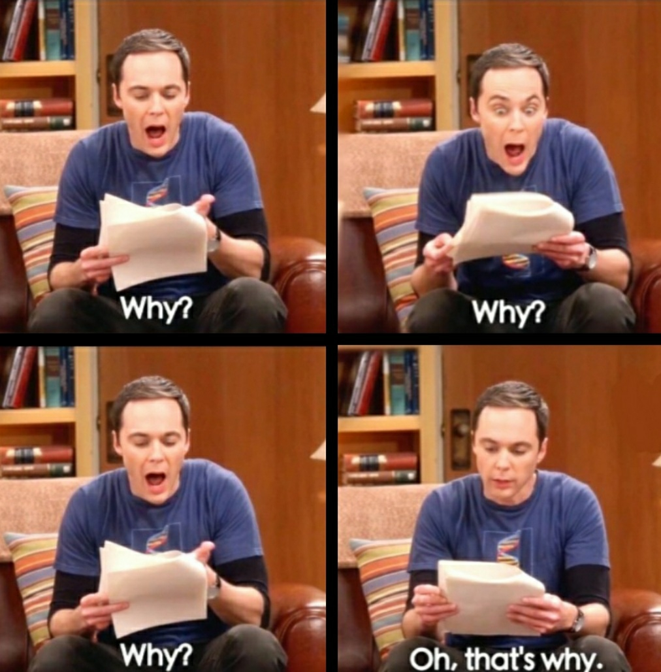

Slide 2
Unit 6.2: Containers
CS2308
Gentry Atkinson

Slide 3
What is a Container?
A variable that stores multiple values is called a container.
Examples:
  Arrays
  Linked Lists

Slide 4
Using Built-In Containers
The <vector> library gives us access to the vector class, which stores many values.
Memory is automatically managed for vectors.
Values in a Vector are stored contiguously in memory.
  What does that tell us?
The storage data type is specified in <square brackets>

Slide 5
Adding and Retrieving Values
push_back: add an element to the back of the list.
front: get the first element in the list
back: get the last element in the list
pop_back: delete the last element in the list
empty: true if size==0

Slide 6
Example 1
int main(int argc, char** argv){
vector<int> v;
v.push_back(1);
v.push_back(2);
v.push_back(3);
while(!v.empty()){
cout << v.back() << ' ';
v.pop_back();
}
cout << endl << "Size: " << v.size() << endl;
} //try to guess the output

Slide 7
For Loops with Vectors
C++ gives us a compact notation to use with Vectors.
for (data type i : vector name)
The loop will run once for each element stored in the list.

Slide 8
Example 2
int main(int argc, char** argv){
vector<int> v;
v = {1, 2, 3};
for (int n : v){
cout << "Number from v: " << n << endl;
}
cout << "Size of v: " << v.size() << endl;
} //try to guess the output

Slide 9
Iterators
The [square brackets] can be used to access elements of Vectors.
Iterators are like references to Vector elements.
The begin and end member functions return iterators to the first and last elements.
Iterators can be incremented and de-referenced like pointers.

Slide 10
Example 3
int main(int argc, char** argv){
vector<int> v;
v = {1, 2, 3};
cout << "v[0]: " << v[0] << endl;
vector<int>::iterator i = v.begin();
for (; i < v.end(); i++){
cout << *i << ' ';
}
cout << endl;
} //try to guess the output

Slide 11
Sources of Info
https://www.geeksforgeeks.org/vector-in-cpp-stl/
https://en.cppreference.com/w/cpp/container/vector
https://www.cplusplus.com/reference/vector/vector/

Slide 12
Questions or Comments?

